Slide 1







Email Spam Detector
Machine Learning Project 2024
Team Members:
Emre Beray Boztepe
Valery Tarasenko
Anuj Jhunjhunwala
24/01/2024

Slide 2

Objective Email Spam Detection (classify emails as “spam” or “not spam”)
The goal of the project is to develop a system that can classify emails into two categories: “spam” and “not spam.” This task is important for email filtering and management because it helps users identify unwanted or potentially dangerous messages.
To train our Machine Learning Model, we used a prepared Excel file “spam.csv” consisting of two classes: “spam” and “ham”.

Slide 3

Why is Email Classification Important?
Phishing Prevention - reduce the risk of falling victim to phishing attacks;
Inbox Organization - maintain a clutter-free inbox;
Security Enhancement - avoid engaging with potentially dangerous content;
Privacy Protection - users can maintain a higher level of personal and organizational privacy.

Slide 4
Examples of Scam Emails:
Advertisements attempting to sell a product or service
Money scams, like the infamous "Nigerian Prince" or "foreign money exchange" schemes (someone overseas who claims to be royalty)
Malware alerts claiming the detection of malware on your devices
Unrealistic promises, such as get-rich-quick schemes, miracle diets, and incredible discounts ("Black Friday deals")
Lottery winnings and other enticing offers

Slide 5
Our Approach
1. Data Cleaning
2. Exploratory Data Analysis (EDA)
3. Data preprocessing
4. Model Building and Evaluation
5. Improvement

Slide 6
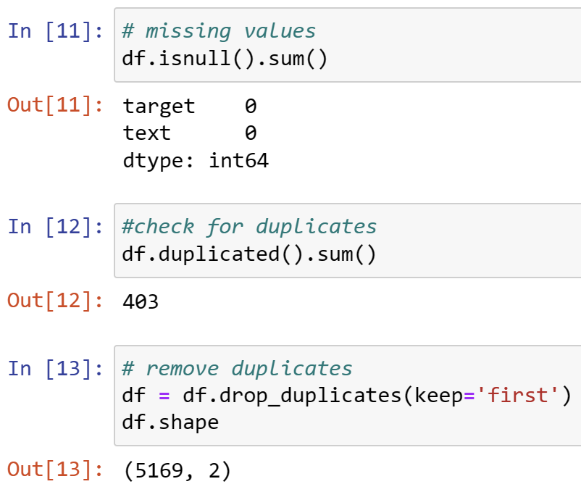
Data Cleaning
Checking the shape and information of the dataset to identify the number of rows, columns, data types;
Renaming columns for better readability, converting 'v1' to 'target' and 'v2' to 'text’;
Encoding the target variable ('spam' or 'ham') using LabelEncoder;
- encoder = LabelEncoder()
Handling Missing Values;
Removing Duplicates
- df = df.drop_duplicates(keep='first’).

Slide 7
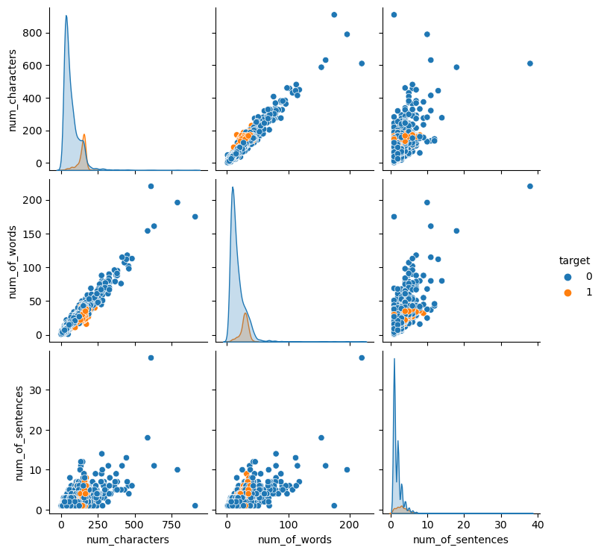
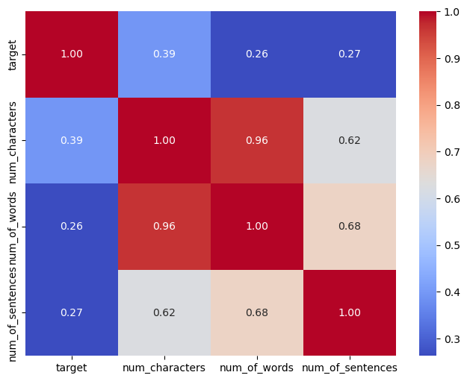
Exploratory Data Analysis (EDA)
Creating pie chart to visualize the distribution of spam and non-spam classes;
- plt.pie(df['target'].value_counts(), labels=['not spam','spam'], autopct="%0.2f")
plt.show()
Analyzing the distribution of the number of characters, words, and sentences in the text data;
- round(df[['num_characters','num_of_words’, 'num_of_sentences']].describe(), 2)
Plotting histograms to explore the distribution of the number of characters and words in spam and non-spam emails;
Plotting pair plots and a heatmap to see correlations between numeric features

Slide 8
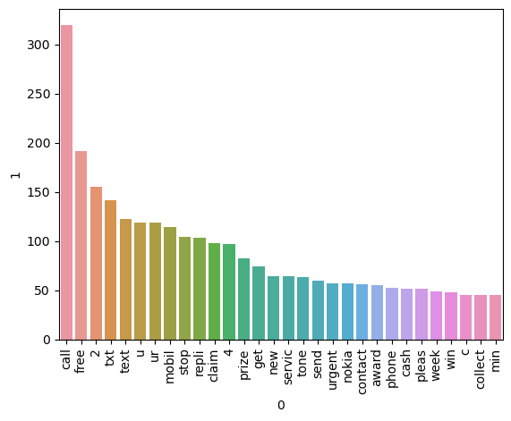
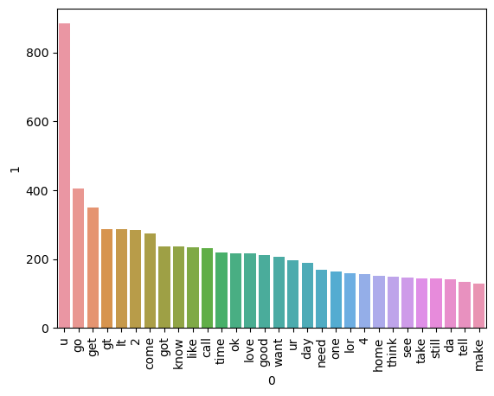
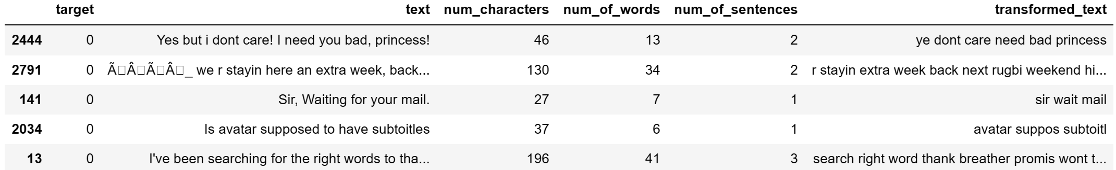
Data Preprocessing
Top 30 words used in the spam emails
Text Transformation
converting the text to lowercase;
tokenizing the text into a list of words using NLTK's word_tokenize function;
removing Special Characters;
removing Stop Words and punctuation);
Creating separate collection (corpora) of words for spam and non-spam emails;
Generating bar plots to visualize the top 30 words used in both spam and non-spam emails.
Top 30 words used in the not spam emails
DataFrame after the transformation.

Slide 9
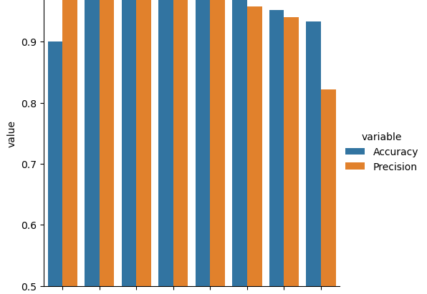
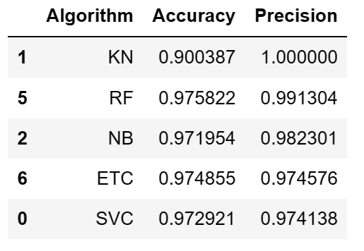
Model Building and Evaluations
TF-IDF Vectorization (converting the preprocessed and transformed text data (transformed_text) into numerical features);
Splitting into training and testing sets;
Initializing Naive Bayes classifiers (GaussianNB, MultinomialNB, BernoulliNB);
Classifier Training and Evaluation
Def train_classifier(clf,X_train,y_train,X_test,y_test):
clf.fit(X_train,y_train)
y_pred = clf.predict(X_test)
accuracy = accuracy_score(y_test,y_pred)
precision = precision_score(y_test,y_pred)
return accuracy,precision;
Visualizing the Model Performance

Slide 10
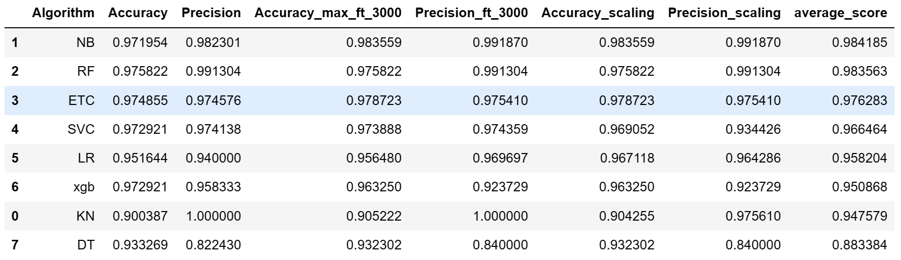
Model Emprovement
Changing max_features parameter of TfIdf;
Scaling Features with MinMaxScaler;
Comparison and Ranking;
Voting Classifier (checking if combination of the top 3 models perform better);
Stacking Classifier (obtaining weightage to the combination of the classifiers according to the final estimator):
The StackingClassifier combines the predictions of Naive Bayes, Random Forest, and Extra Trees classifiers with a final estimator (Random Forest in our case).
clf = StackingClassifier(estimators=estimators, final_estimator=final_estimator)
Accuracy: 0.9825918762088974
Precision: 0.96875

Slide 11
Conclusion
We observe that the combination of Naive Bayes, Random Forest and Extra Trees Classifier gave fairly good results.
The Stacking Classifier did not give good results, so it can be concluded that we can use the combination of these classifiers in equal weightage.

